Slide 1

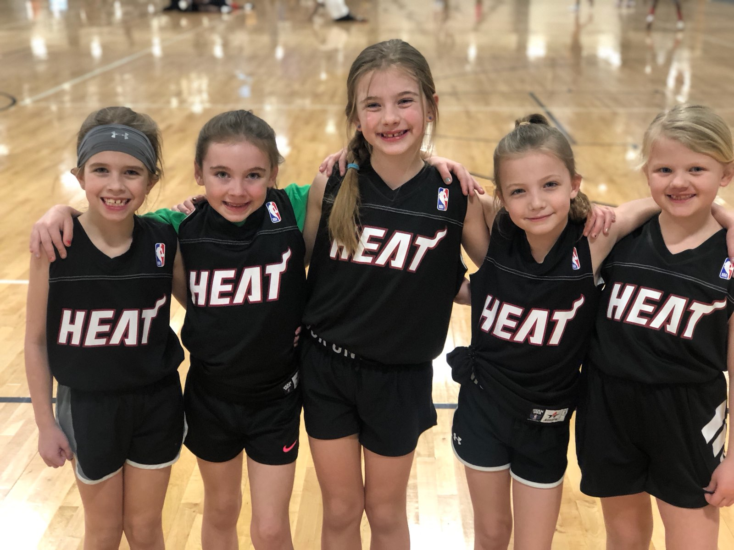
Coaches Meeting
Girls Jr. NBA Basketball
Dec. 11, 2024

Slide 2
Housekeeping
Handouts
  Copy of PowerPoint Slides
  League Rules
  Indemnification form
  Fall/Winter Program Guide
1 hour meeting
Hold questions until the end please

Slide 3

Thanks!
Thank you for coaching and volunteering your time to mentor young kids.
Great way to make a difference in our community.

Slide 4
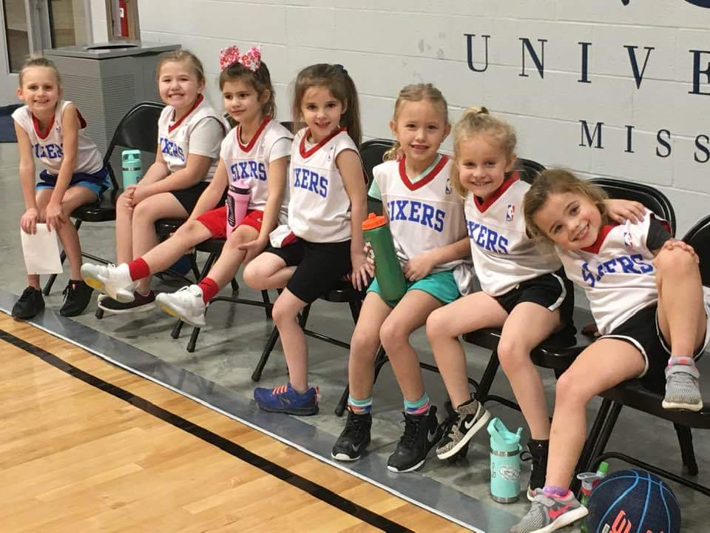
Our Goal
Provide a safe, fun, and enjoyable youth sports experience for the kids in our community.

Slide 5
League Formation
Grade | *Night | # of Teams
Kindergarten | Thur. | 6
1st Grade | Thur. | 10
2nd Grade | Thur. | 6
3rd Grade | Thur. | 8
4th Grade | Thur. | 6
Total |  | 36

Slide 6
Team Names/Jerseys
Your reversible NBA-replica jerseys will match your team name.
Jerseys should arrive in 1-2 weeks. I will email you when they are ready, so you can come pick them up at The Linc and distribute them to your team.

Slide 7
Background Checks
As part of the Coach’s Registration, we also require all head coaches to submit their information for an online criminal background check through the Background Investigation Bureau (BIB).
Once you submit your info., it only takes about 1-2 days to be approved.

Slide 8
Team Sites
I have published your online team sites so you can see the players on your roster, the parents, and their contact information.
You and your team’s parents received an automatic email on Dec. 5 with a link to your team site from TeamSideline.

Slide 9
Team Rosters
Teams were formed by
  1. school
  2. reciprocal buddy requests
For grades K-1 (3 v. 3) rosters should have about 6 players.
For grades 2-4 (5 v. 5) rosters should have about 10 players.

Slide 10
Communications
If you haven’t already, please contact your team parents ASAP to:
  introduce yourself
  let them know they are on your team
  inform them about practices
  verify their contact information, etc.
There are also many free apps available for team communication like GroupMe, Team Snap & Remind.

Slide 11
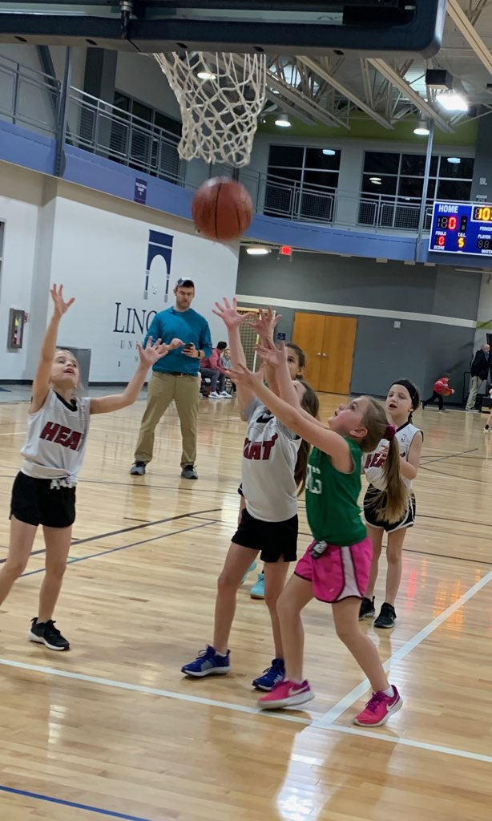
Parent Meeting
Please set up a Parent Meeting so they can meet you and so you can go over your expectations, goals, etc.
This can just be a quick meeting for 5-10 minutes before your first practice, but it is important for parents to get to know you & trust you.
Sample Goals:
  Have fun
  Get better
  Use good sportsmanship

Slide 12
Indemnification Form:
Each parent on your team must fill out an Indemnification Form and return it to the Head Coach.
Also on the league website.
Important info. including indemnification, treatment authorization, emergency contact information, and medical conditions.
Please distribute, collect, and keep these forms until the season is over.
You do not need to submit these forms to me.

Slide 13
Certification Course
We certify all of our Head Coaches through online courses from the National Alliance for Youth Sports (NAYS).
If you are a new coach to our programs, you will need to take the following 3 courses:
  Coaching Youth Sports Intro. (1 hour)
  Basic Youth Sports Safety & First Aide (45 minutes)
  Basketball U10 (30 minutes).
These courses are free and can be done online at your leisure, but please allow 2-3 hours for this.
I will send you an automatic email through NAYS soon with a link to the course(s) with a due date.

Slide 14
Certification Course (continued)
After completion of thecourses, coaches become full members of NAYS.
As members, coaches receive:
  $1,000,000 excess liability insurance coverage in case he/she becomes liable for an occurrence while coaching.
  access to a members-only section of the NAYS website, with coaching resources and additional training opportunities.
If you have taken the general course, but not the basketball course, I will add that for you.
If your membership has expired, I will renew it for you.

Slide 15
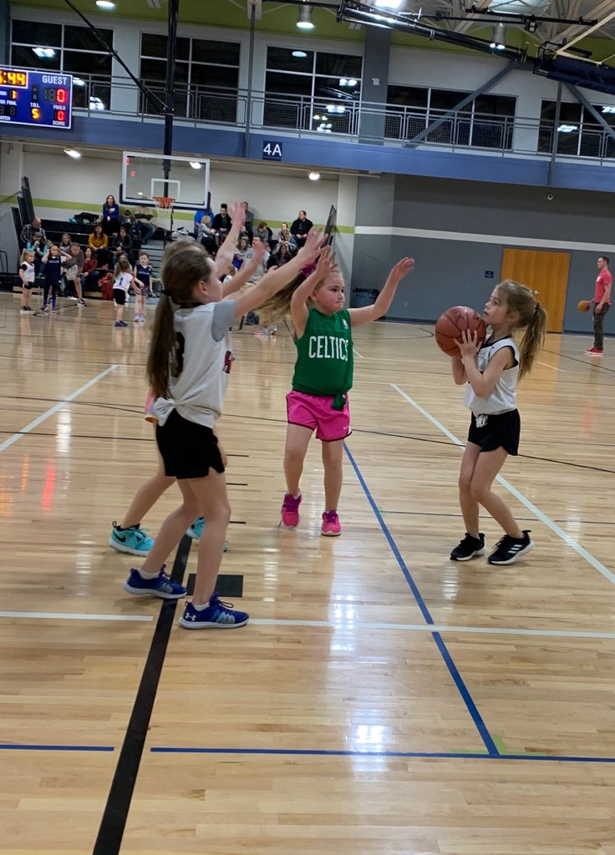
Assistant Coaches
Assistant Coaches do not need to complete the Coach’s Registration, submit the background check, or take the certification courses.

Slide 16
Game Schedules
All teams will play 6 games.
Games are once a week
Games will begin on Jan. 9.
All games will be at The Linc.
Game schedules are posted at: teamsideline.com/jeffersoncity.
Changing the game schedule effects many teams, officials, & staff, so I don’t accommodate.
If you can’t play, I will offer your game to another team. You forfeit the game with no make-up or refund.

Slide 17
Game Times
Games will start at either:
  5:30, 6:15, 7:00, 7:45, or 8:30 PM.
Games are about 40-45 minutes each
  Four 8-minute quarters with a continuous running clock and a 2-minute halftime.
If time permits, teams can warm-up on half of the court prior to each game.
For grades K-1 (half-court games), please split the available time and give each team equal time at the basket and center court.

Slide 18
Cancelations
  In case of inclement weather, please sign up to receive text alerts from JC Parks via TeamSideline.
  An email will also be sent to coaches & parents.
  I will also post all cancellation at: jcparks.com/cancellations.
  We usually decide on cancellations at about 3 PM.
  Please do not contact us, it only slows down the process. We will notify you ASAP.

Slide 19
Practices
Below are our policies and procedures for Head Coaches who would like to practice at The LINC:
  Head Coaches may begin making reservations, under their name, Thur. Dec. 12 beginning at 9:00 AM.
  Please call the front desk staff at 573-634-6482.
  You can reserve pre-season and in-season practices from Dec. 12 to Feb. 26.
  These practices are free, but we have limited availability.
  Due to high demand, only 1 per week for 1 hour each.

Slide 20
Practices (cont.)
  Grades K-1 can reserve a half-court. Grades 2-4 can reserve a full-court.
  Before practice, our Facility Supervisor will lower the goals to the appropriate height for your grade.
  We will not provide basketballs, so players need to bring their own.
  We must keep 1 court open at all times for Lincoln Univ. students & Linc members.
  You’re free to practice elsewhere if you have access to other gyms.

Slide 21
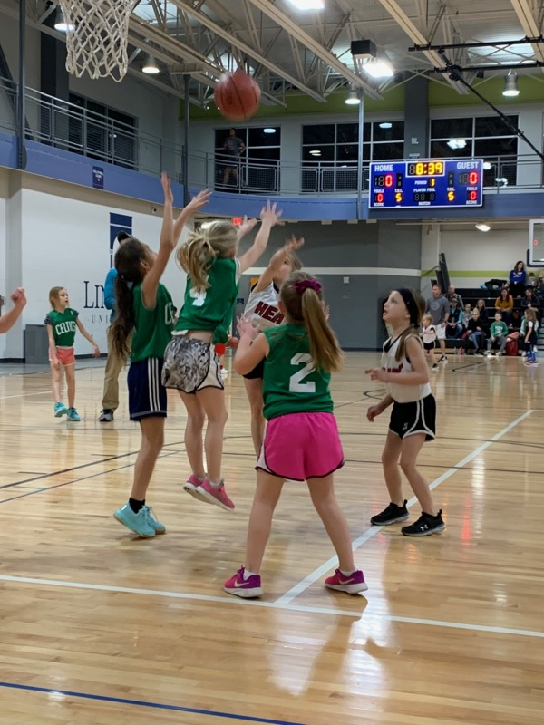
League Rules:
  Complete league rules are on the league website.
  Please be very familiar with the rules of your grade/division.

Slide 22
Scores/Standings & Awards
Score & standings are not kept for grades K-1, but are for grades 2-4.
All players will receive an award medal at the end of the season.
  Will be in an envelope with your jerseys.
  Save and hand them out after your last game.

Slide 23
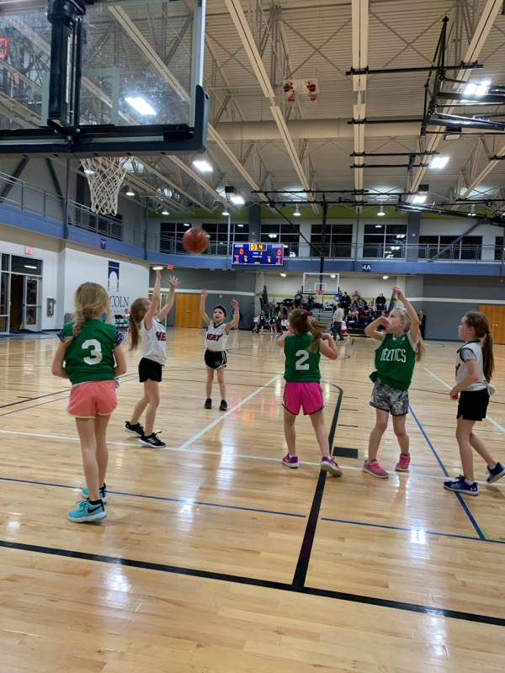

Slide 24
Volunteer Scorekeepers
For grades K-1:
  We do not keep score, so a volunteer is not needed to run the clock.
  Coaches will start the clock and let it run until time expires for each quarter.
  Games are half-court and the clock shows the same for both sides (i.e. 1A & 1B), so all 4 teams must be ready to begin.

Slide 25
Volunteer Scorekeepers (cont.)
For grades 2-4:
  Each team is responsible for supplying one volunteer for each game.
  We need one volunteer to complete the scoresheet and one to run the clock.
  Please make sure your volunteer at least writes down the final score.
  Simple directions on how to run the scoreboard are on the score table.

Slide 26
Team Equipment
  We will provide a few basketballs to each team for warm-up and 1 game ball.
  Placed under the score table in a mesh bag.
  Please make sure all basketballs are returned to the bag after use.

Slide 27
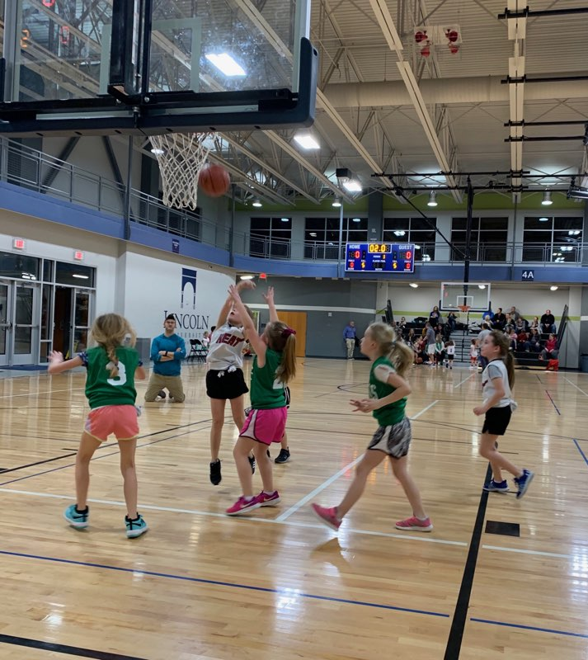
Jewelry
  For player safety, jewelry (ear rings, necklaces, bracelets, etc.) are not allowed while playing.

Slide 28
Jerseys
Each participant receives an NBA-replica jersey that corresponds to their team name.
Jerseys are reversible.
  Home team will wear light side out.
  Away team will wear dark side out.
All jerseys must always be tucked.

Slide 29
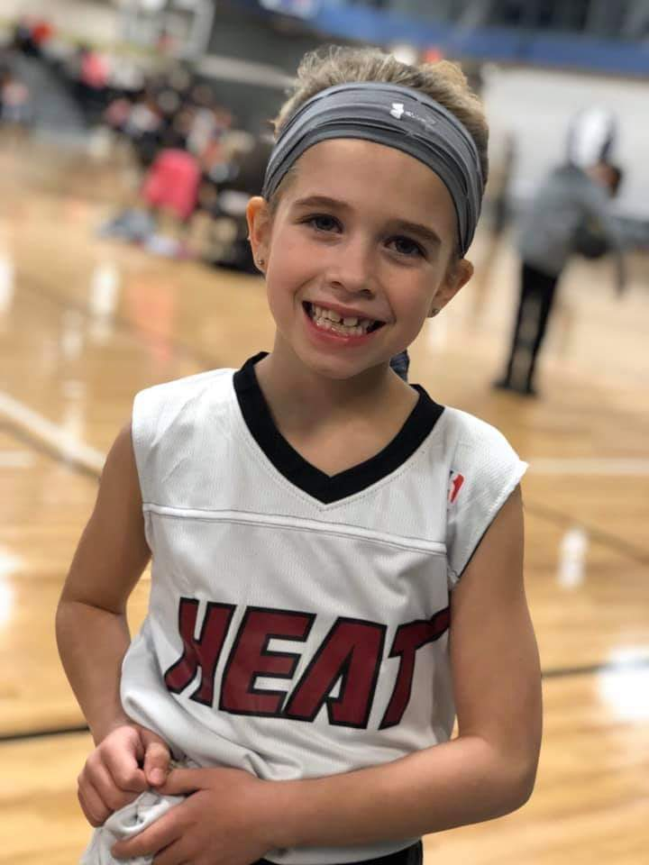
Sportsmanship
Everyone must always use good sportsmanship and conduct themselves in a professional and respectful manner.
This includes all coaches, players, parents, and fans.
Head Coaches are responsible for the behavior of everyone associated with their team.

Slide 30
Sportsmanship (Cont.)
  We have a zero-tolerance policy and will not tolerate bad sportsmanship from anyone.
  Consequences will include ejections, suspensions, removal from the league and any means necessary to ensure the kids have a safe, fun, and enjoyable youth sports experience.

Slide 31
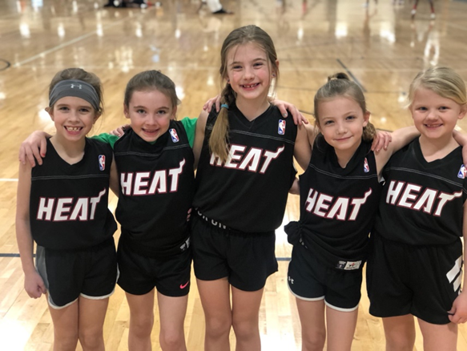
Sportsmanship (Cont.)
  Please respect your opponent and do not run up the score.
  Please sub different kids in at various positions to help keep the score more competitive when needed.

Slide 32
Playing Time
Equal playing time is required.
I’ve found that it works well to plan playing time before the game begins and have it written or typed on a sheet for your reference during the game.

Slide 33
Sample Playing Time Chart

Slide 34
Officials/Supervisors
For grades K-1, the coaches are the officials. Please bring a whistle.
For grades 2-4, we will provide 2 Officials for each game.
A Facility Supervisor will also be on-hand at The Linc during all games.
The Supervisors wear bright-colored uniform shirts so you can spot them easily.
If you need assistance, please ask them. Please report all emergencies, accidents, incidents, etc. to them ASAP.
Please be considerate and respectful in all dealings with the Officials & Facility Supervisors.

Slide 35
Survey
At the end of each season, we will email a brief (7-question) online survey to all coaches and parents.
Please take the time to offer us constructive feedback so we can continue to improve all aspect of our operations and service.

Slide 36
Questions?

Slide 37
Thanks again!
I hope this information has been helpful and has answered all of your questions.
Please let me know if you have additional questions or need assistance at any time.
Thanks again for coaching and thank you for your time and efforts as we all work together to provide a safe, fun, and enjoyable youth sports experience for the kids in our community
Steve Schellman
JC Parks
Sr. Program Manager of Youth Sports
Certified Youth Sports Administrator (CYSA)
573-634-6493
sschellman@jeffersoncitymo.gov

